Slide 1


UAV Visual Landing Aid
Tai Pham
Kimball Davis

Slide 2
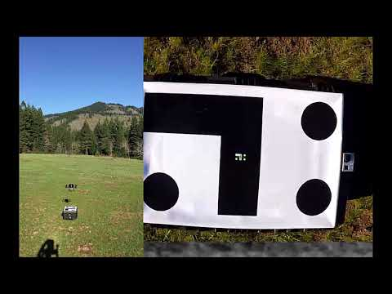

Slide 3
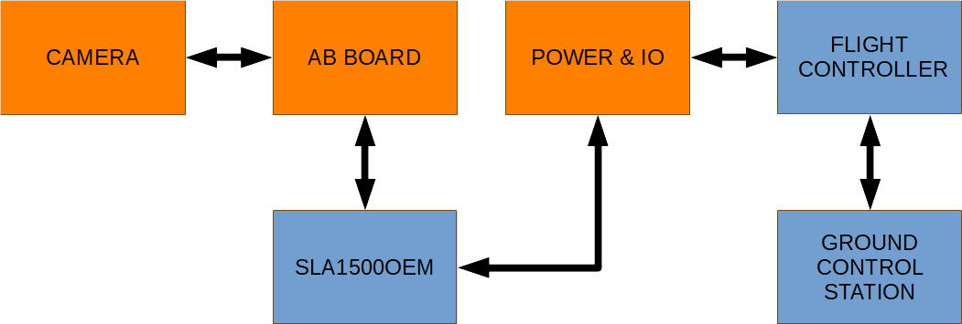

Slide 4
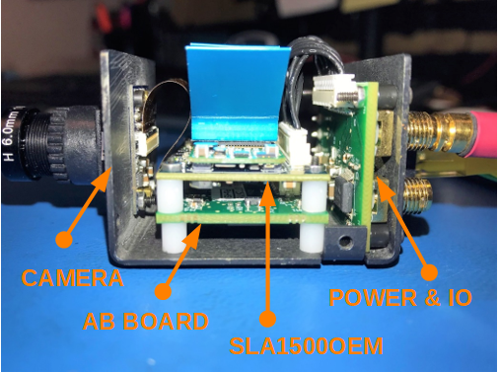

Slide 5


Slide 6
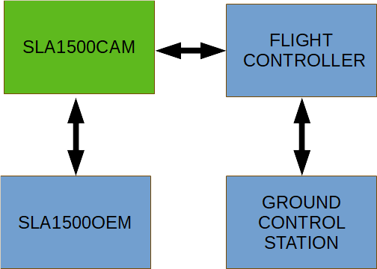

Slide 7
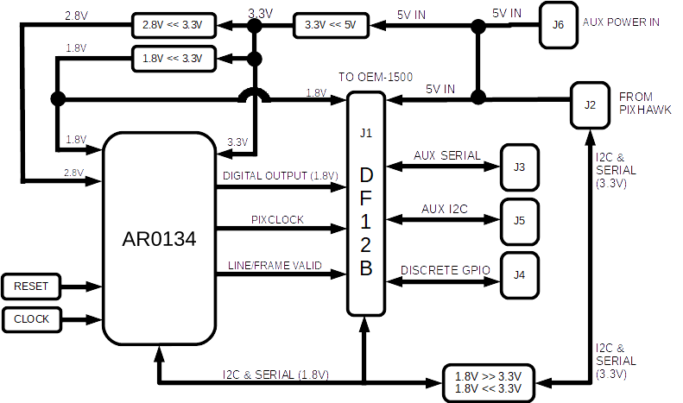

Slide 8
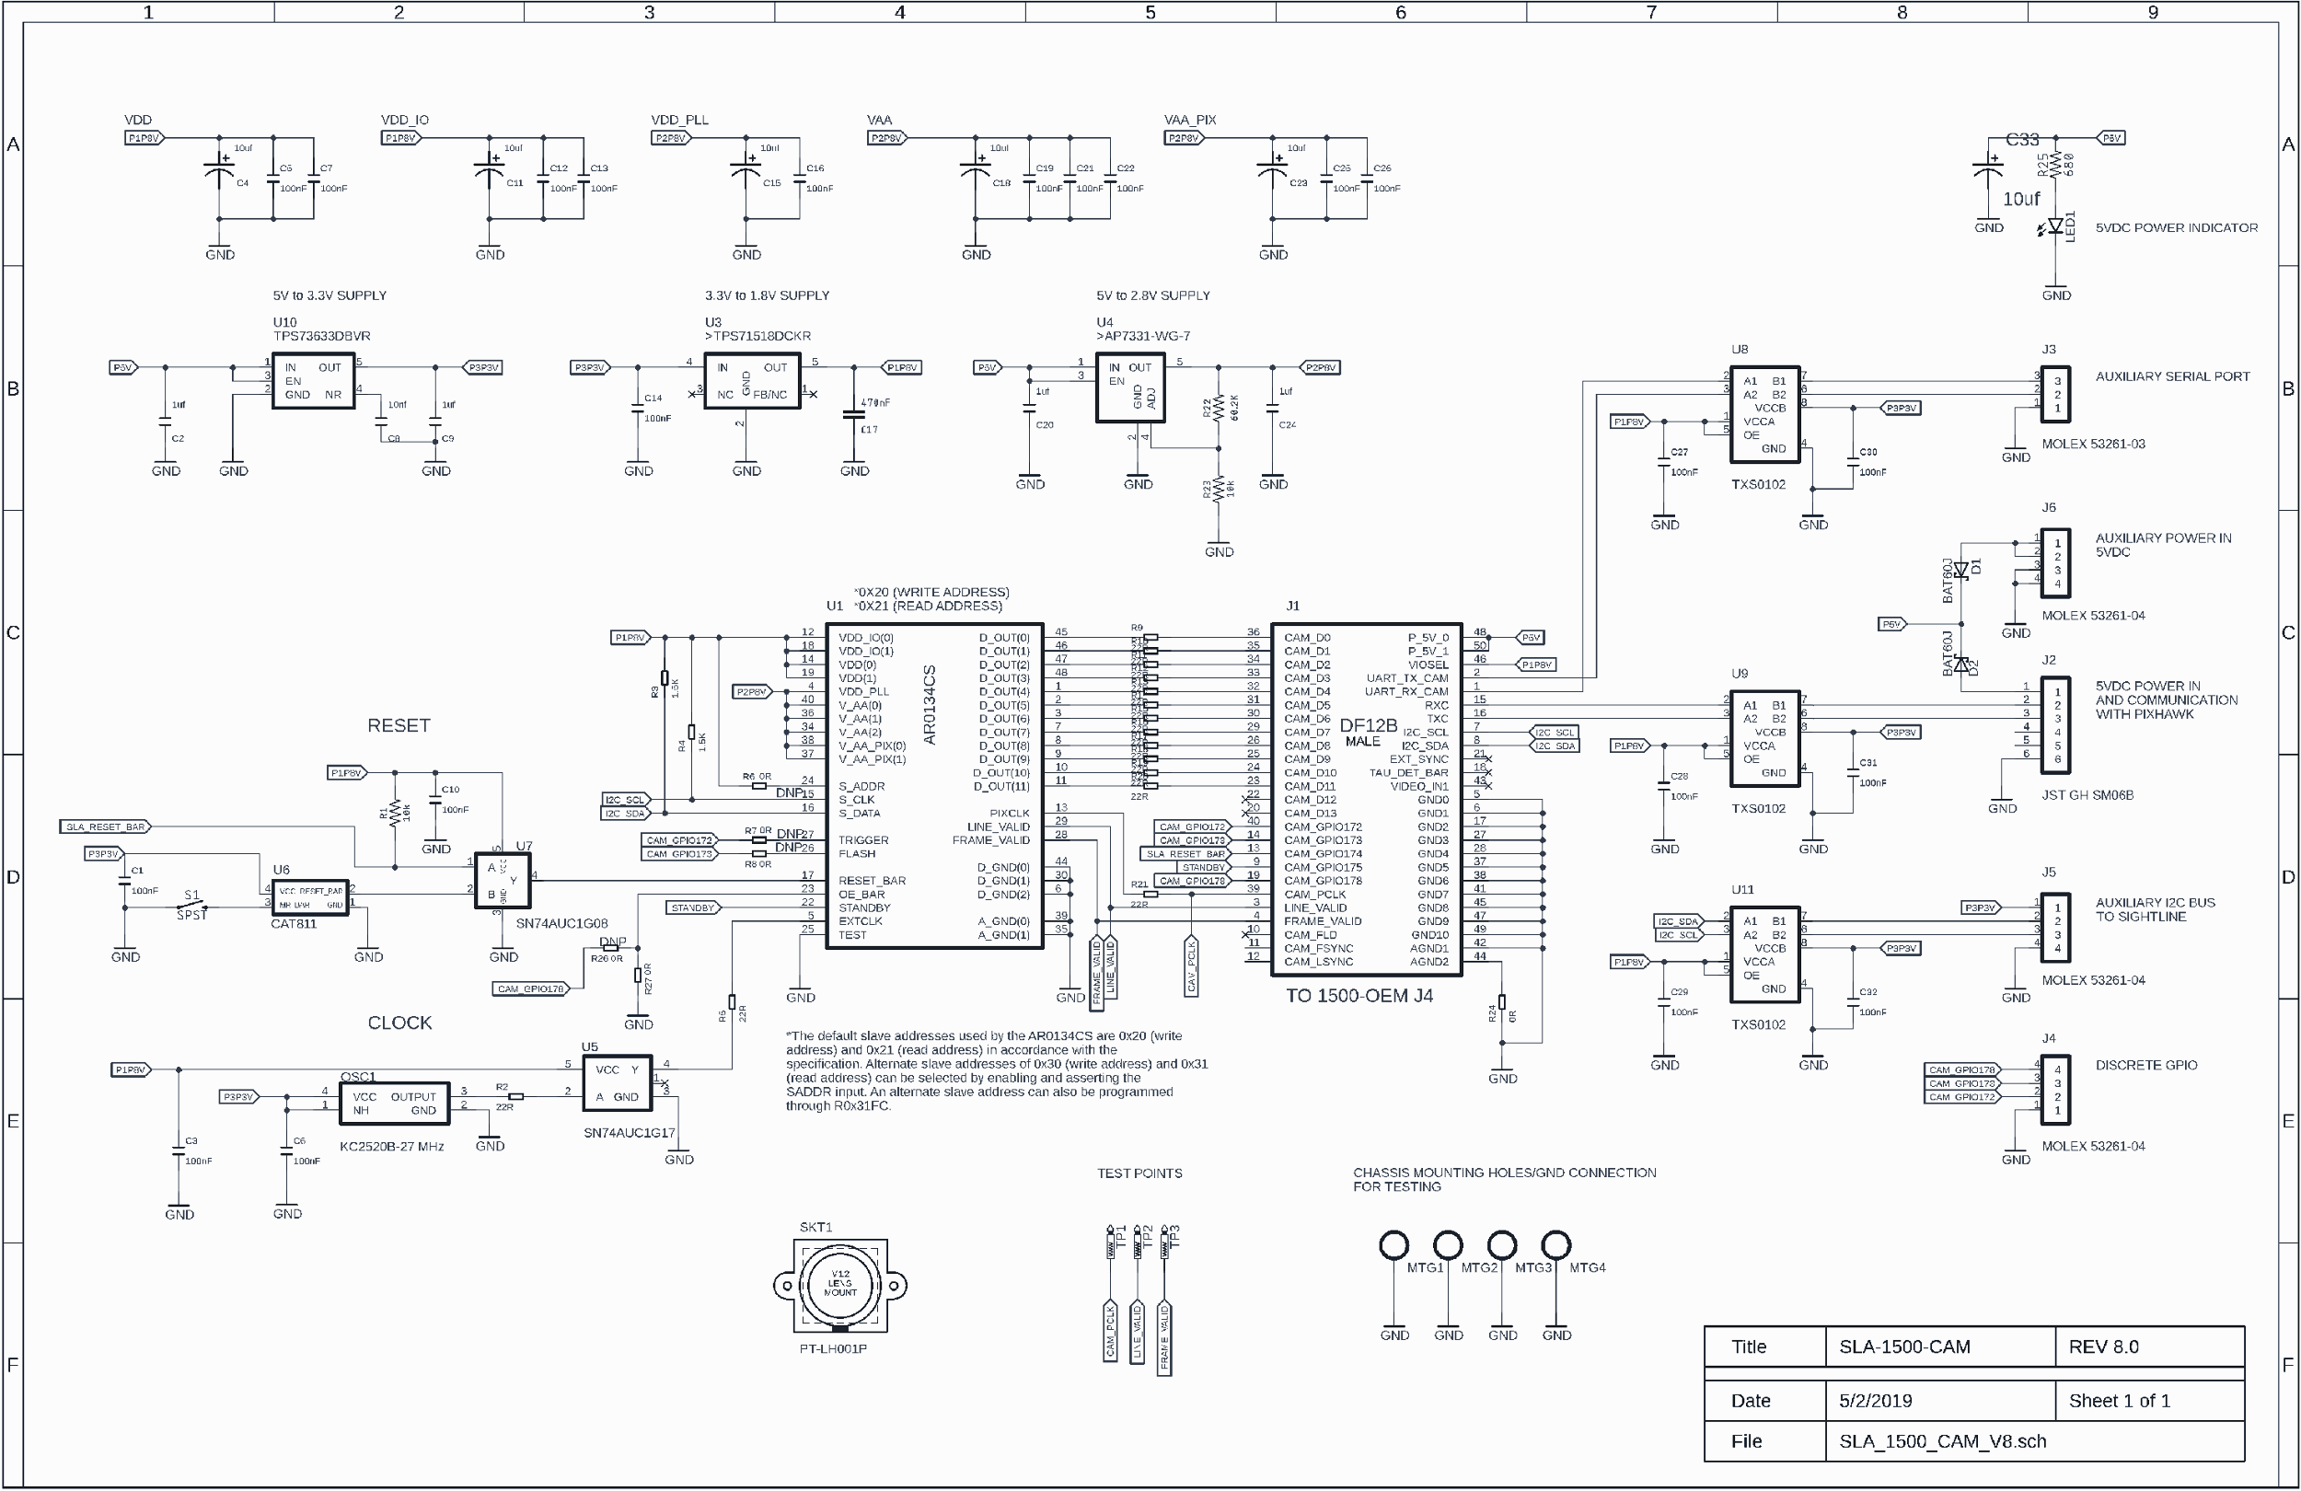

Slide 9
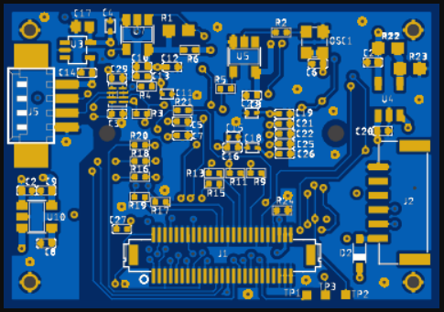
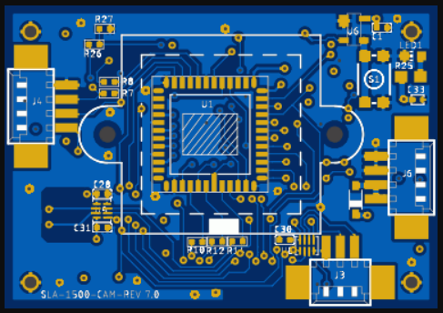

Slide 10
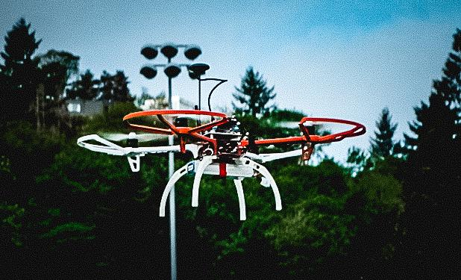

Slide 11
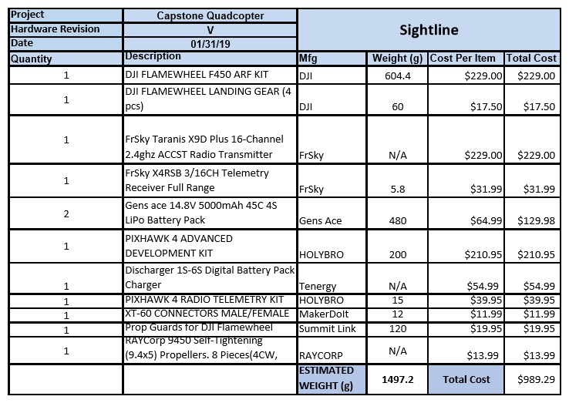

Slide 12
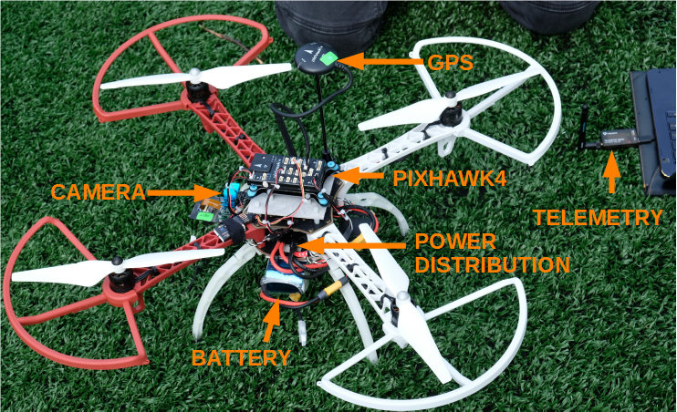

Slide 13
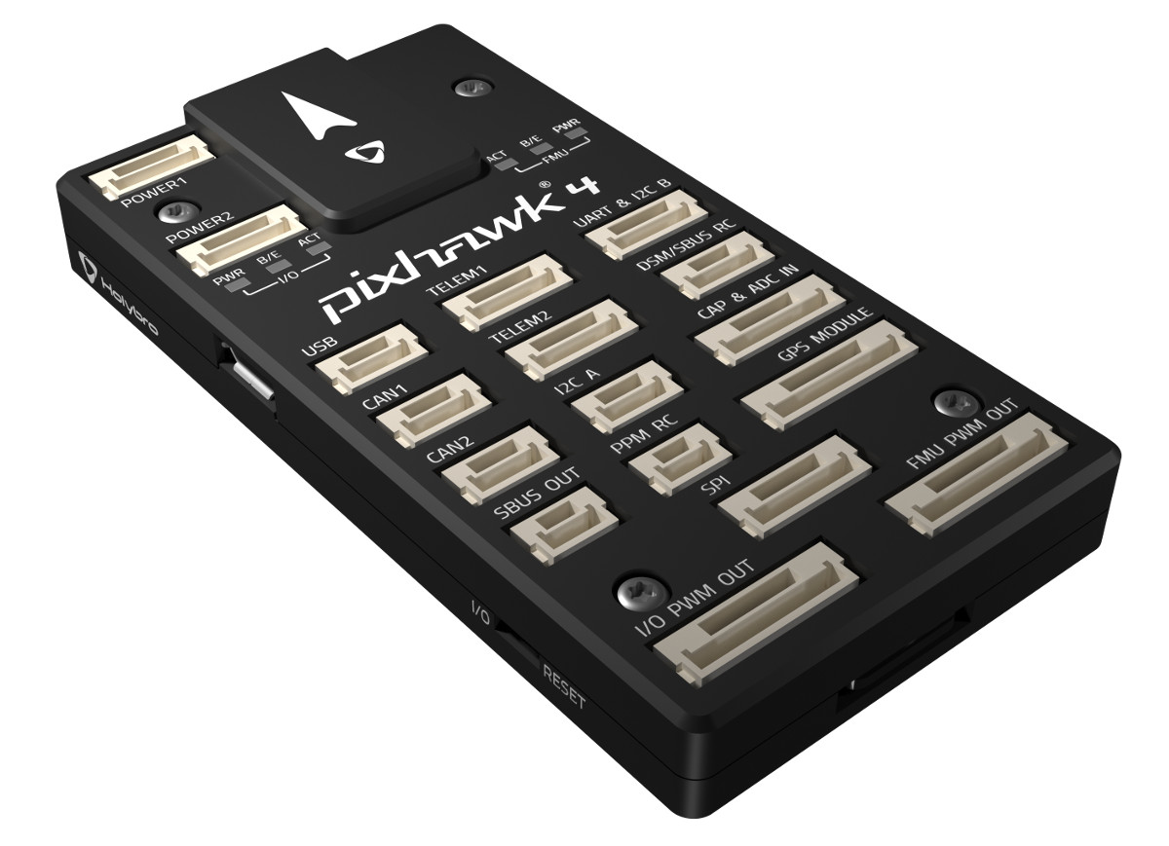
Pixhawk 4
Light weight
Multi options for communication protocol
Internal and external GPS
Easy to setup
Plug and play
Work with all autopilot softwares
Notes:
Weight: 16g
Communication like CAN, I2C, Serial BUS.
Made by Holybro and PX4 team. Easily install and update firmware using PX4 firmware and groundcontrol station or Qgroundcontrol
Connected to Power Management board which can provide upto 15 mins flying with one single 4S battery which can also provide power for the SLA camera.
Can be customized to work with a lot of ground control station.

Slide 14

Qgroundcontrol
open-source software
Create a mission and fly autonomously
Control the drone fully and wirelessly.
Plug and play
Notes:
The laptop that installs the Qgroundcontrol is called Ground Control Station (GCS). Qgroundcontrol allows users/ developers adjust and control every single parameter of the drone as well as set up a mission for the drone flying autonomously including take-off and precision landing.

Slide 15
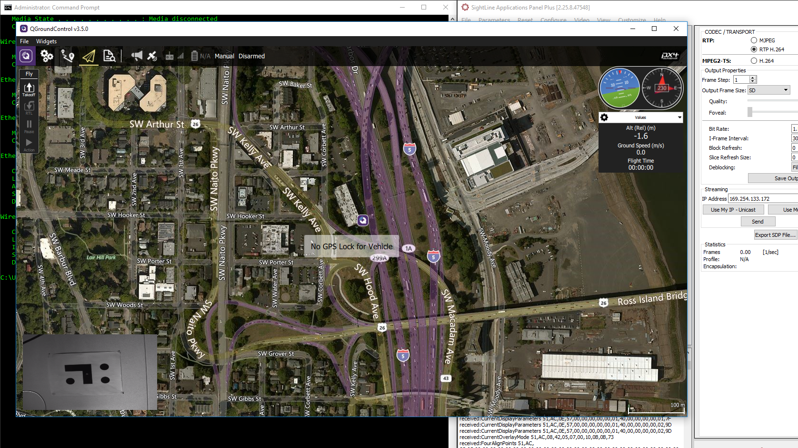

Slide 16
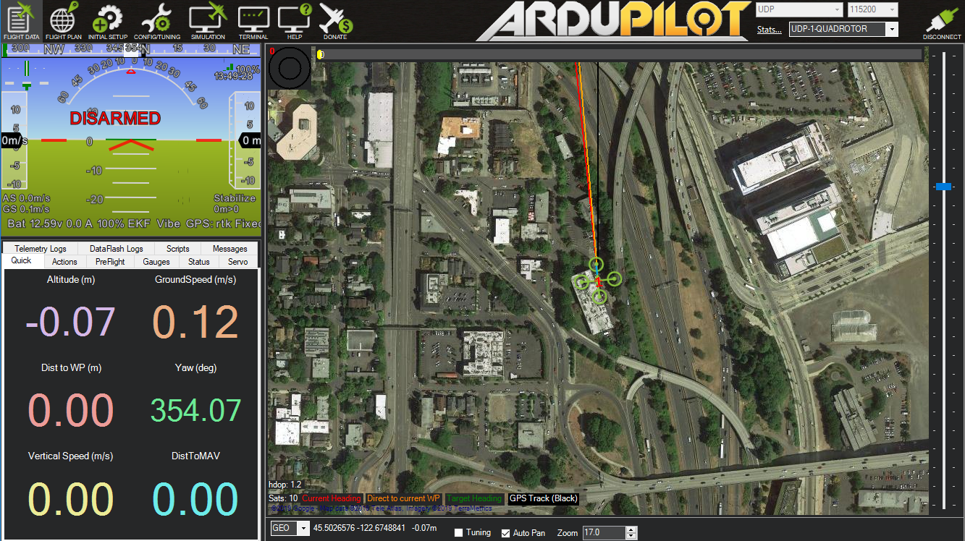

Slide 17
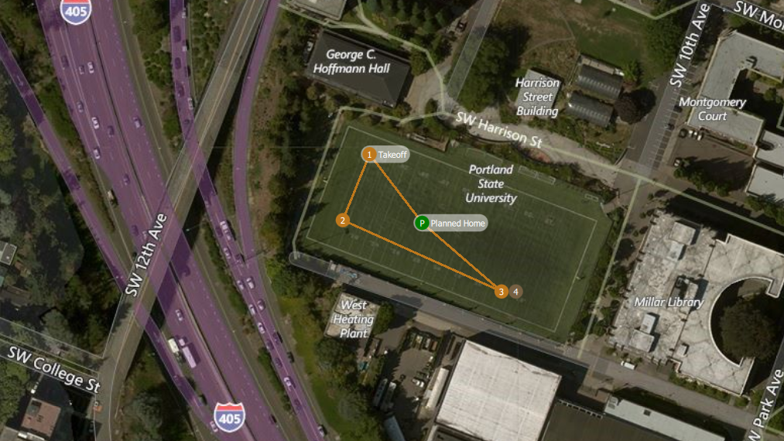

Slide 18
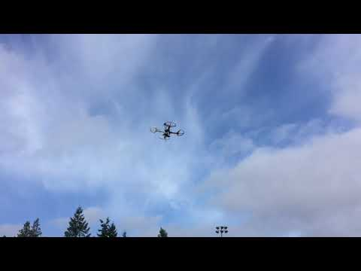

Slide 19
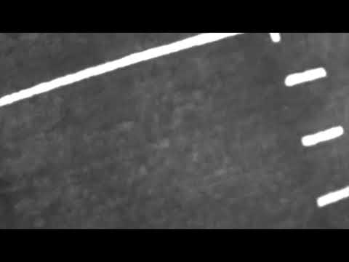

Slide 20
What’s Next?
Hardware bringup on SLA1500CAM
The communication between SLA1500 and Qgroundcontrol (software)

